Slide 1

PROJECT 5
TELLCO
TELECOM USER
ANALYTICS
~BY SIDDHEYA LOHAR

Slide 2
BUSINESS PROBLEM
01
BUISNESS PROBLEM
TellCo wants to understand its customers better before making strategic decisions regarding customer acquisition and business growth.
THE ANALYSIS FOCUSES ON
  TellCo wants to understand its customers better before making strategic decisions regarding customer acquisition and business growth.Understanding who the users are
  Measuring customer engagement
  Evaluating network experience
  Measuring customer satisfaction
  Identifying high-value customer segments
  Providing insights that can support future business decisions

Slide 3
OBJECTIVES
FOUR CORE OBJECTIVES
USER OVERVIEW
ENGAGEMENT ANALYSIS
EXPERIENCE
ANALYSIS
SATISFACTION ANALYSIS
  Number of users
  Session behaviour
  Handset manufacturers
  Handset types
  Traffic characteristics
  Session frequency
  Session duration
  Data consumption
  Engagement score
  Customer segments
  TCP retransmission
  RTT
  Throughput
  Network experience
  Experience-based customer segments
  Engagement
  Experience
  Satisfaction score
  Customer segmentation

Slide 4
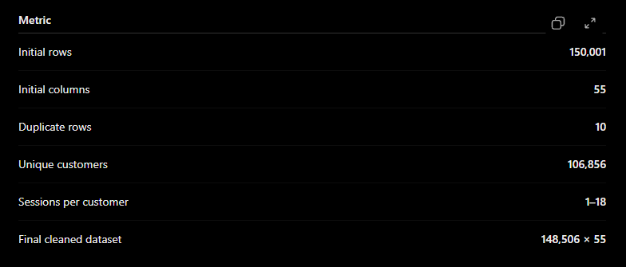
DATASET OVERVIEW
DATASET
DATA DICTIONARY
A SECOND DATASET WAS PROVIDED CONTAINING FIELD DESCRIPTIONS.
It was used to understand the meaning of variables rather than being directly merged with the main dataset.

Slide 5
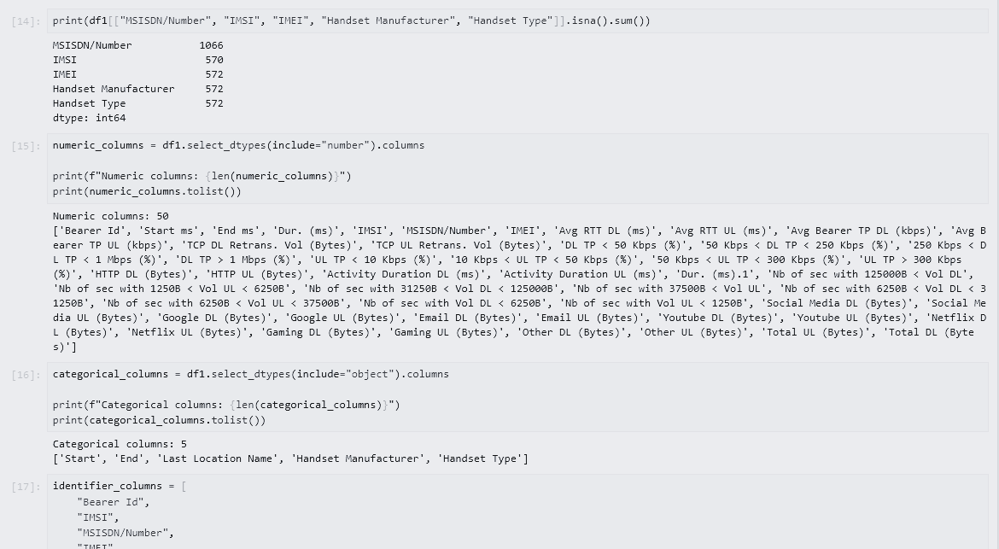
DATA PREPARATION
  Inspected dataset structure and data types
  Removed duplicate records
  Identified missing values
  Investigated numerical distributions
  Identified potential outliers
  Reviewed categorical variables
  Examined highly correlated/redundant variables
  Prepared data for customer-level aggregation
CLEANING &
PREPARING
FINAL DATASET
148,506 rows × 55 columns

Slide 6
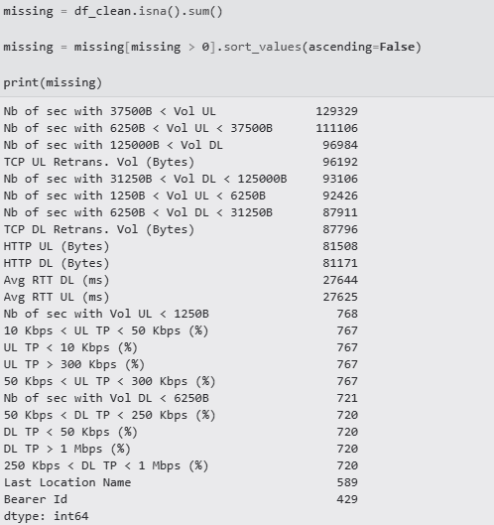
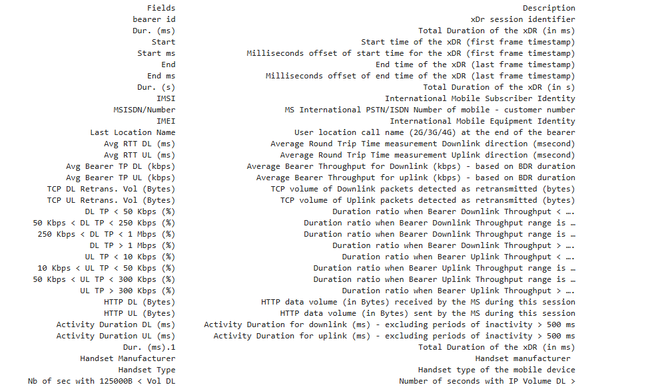
MISSING VALUE
MISSING VALUES WERE EXAMINED ACROSS ALL NUMERICAL AND CATEGORICAL VARIABLES.
34 COLUMNS: LESS THAN 1% MISSING
2 COLUMNS: 1–20% MISSING
10 COLUMNS: MORE THAN 50% MISSING

Slide 7
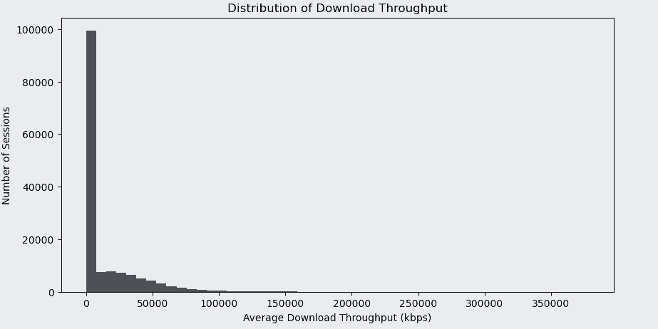
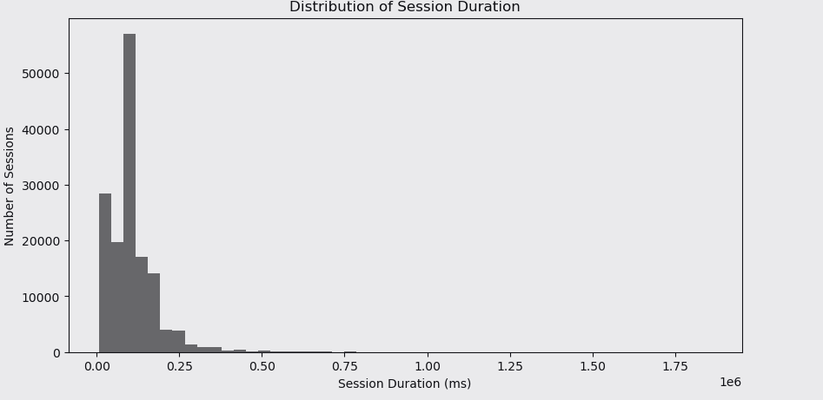
IMPORTANT CORRELATION
  DUR. VS DUR.1 → 1.000
  Total DL vs Gaming DL → 0.999
  Activity Duration UL vs DL → 0.905
  Low-volume UL/DL seconds → 0.947
CORRELATION & REDUNDANCY ANALYSIS

Slide 8
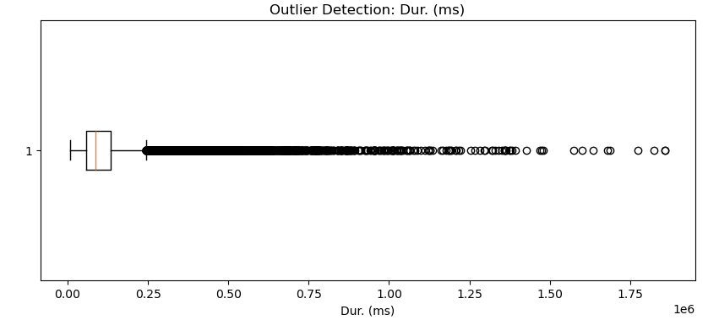
OUTLIER ANALYSIS
OUTLIER DETECTION
DL TP > 1 Mbps (%)
10 Kbps < UL TP < 50 Kbps (%)
  36,744 observations
  24.79%
  31,691 observations
  21.39%

Slide 9
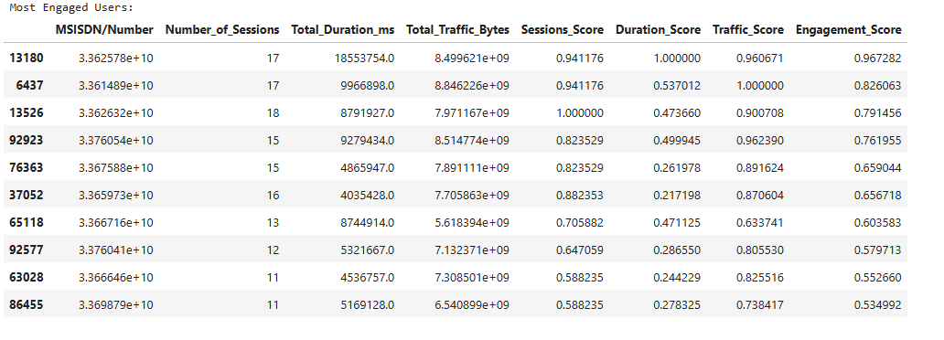
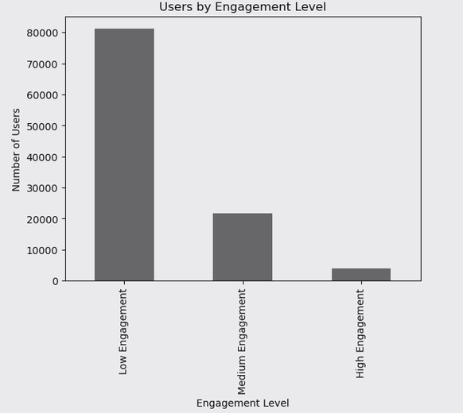
CUSTOMER & USAGE OVERVIEW
  Number of sessions
  Session duration
  Download traffic
  Upload traffic
  Handset manufacturer
  Handset type
KEY FINDING
106,856 unique customers
USER OVERVIEW ANALYSIS

Slide 10
SESSION FREQUENCY
SESSION DURATION
DATA VOLUME
How often a customer uses the service.
How long the customer remains active.
How much data the customer consumes.
CUSTOMER
ENGAGEMENT

Slide 11
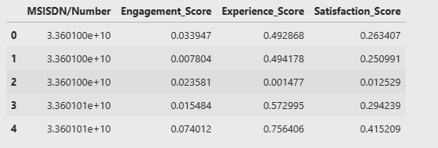
ENGAGEMENT SCORE & TOP CUSTOMERS
ENGAGEMENT RANKING
INTERPRETATION
  Session activity
  Duration
  Data consumption
HIGHER ENGAGEMENT SCORES INDICATE CUSTOMERS WITH STRONGER COMBINED USAGE ACROSS:

Slide 12
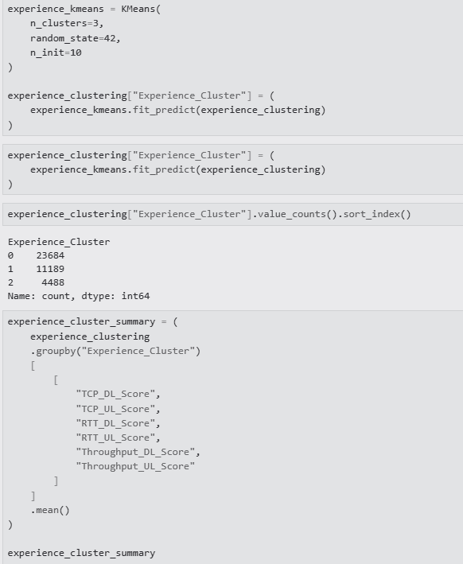
CUSTOMER SEGMENTATION
FEATURES
  SESSION FREQUENCY
  Session duration
  Data usage
  Engagement score / normalized engagement features
K-MEANS CLUSTERING
K-MEANS CLUSTERING WAS USED TO GROUP CUSTOMERS BASED ON THEIR ENGAGEMENT BEHAVIOUR.

Slide 13
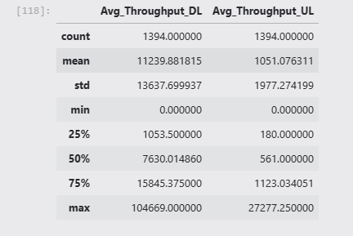
1
2
3
TCP RETRANSMISSION
RTT-ROUND
TRIP TIME
THROUGHPUT
Higher retransmission can indicate network inefficiency or packet delivery problems.
Measures communication latency between the user and network.
Measures the effective data transfer rate experienced by users.
NETWORK EXPERIENCE ANALYSIS

Slide 14
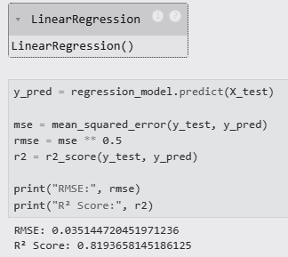

EXPERIENCE SCORING & SEGMENTATION
FOR METRICS SUCH AS TCP RETRANSMISSION AND RTT, LOWER VALUES GENERALLY REPRESENT BETTER NETWORK CONDITIONS, WHILE HIGHER THROUGHPUT REPRESENTS BETTER PERFORMANCE.
EXPERIENCE SCORE
EXPERIENCE SEGMENTATION
INTERPRETATION
THE SELECTED EXPERIENCE METRICS WERE AGGREGATED AT CUSTOMER LEVEL.
The metrics were normalized so that they could be combined into a common score.
CUSTOMERS CAN THEN BE GROUPED BASED ON NETWORK EXPERIENCE USING CLUSTERING.
THE SEGMENTATION HELPS IDENTIFY:
  Customers experiencing better network performance
  Customers with moderate experience
  Customers potentially experiencing poorer network conditions

Slide 15

CUSTOMER SATISFACTION
SATISFACTION ANALYSIS
CUSTOMER SATISFACTION IS DERIVED FROM THE RELATIONSHIP BETWEEN
ENGAGEMENT
EXPERIENCE
  HIGHLY ENGAGED
  Experiencing good network performance
  POTENTIALLY VALUABLE FOR RETENTION
  Showing weaker experience despite high usage

Slide 16
MACHINE LEARNING / REGRESSION
POTENTIAL INPUTS
  Engagement score
  Experience score
  Session behaviour
  Data consumption
  Network performance metrics
OBJECTIVE
Determine which measurable customer/network characteristics are most strongly associated with the satisfaction measure.
PREDICTIVE ANALYSIS
A REGRESSION MODEL WAS PLANNED/IMPLEMENTED TO INVESTIGATE THE RELATIONSHIP BETWEEN CUSTOMER SATISFACTION AND THE UNDERLYING ENGAGEMENT/EXPERIENCE VARIABLES.
EVALUATION
  R²
  MAE
  RMSE

Slide 17
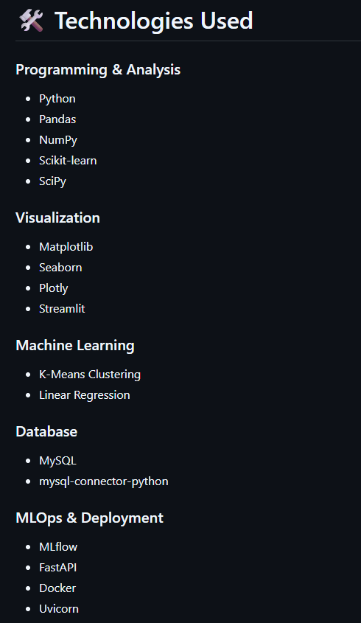
TECHNICAL ARCHITECTURE
PROJECT ARCHITECTURE
TECHNOLOGIES
  PYTHON
  Pandas
  NumPy
  Scikit-learn
  MySQL
  MLflow
  Power BI / Dashboard
  Docker
  Git / CI-CD

Slide 18
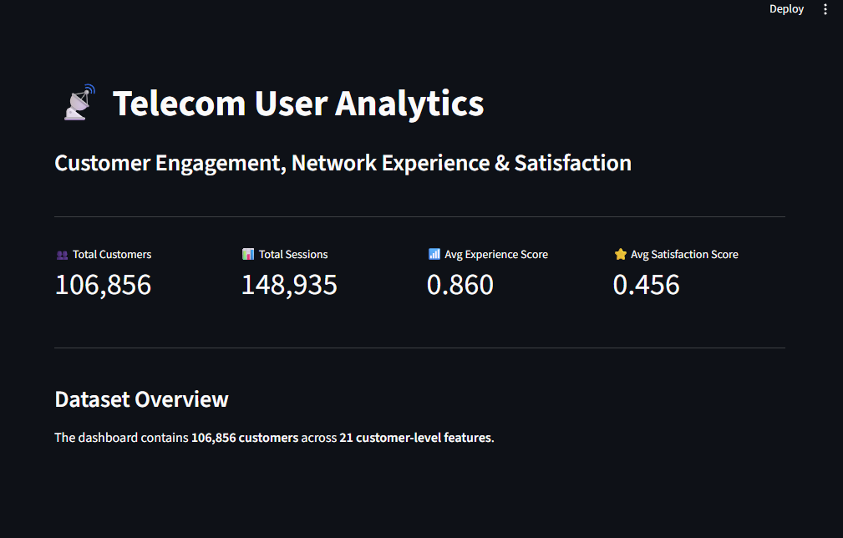
DASHBOARD
BUISNESS INTELLIGENCE LAYER
DASHBOARD KPIS
  TOTAL CUSTOMERS
  Average sessions/customer
  Average engagement
  Average experience
  Satisfaction distribution
  Customer segments
  Handset distribution
  Network performance

Slide 19
KEY FINDINGS
DATASET
DATA QUALITY
  150,001 INITIAL RECORDS
  148,506 records after cleaning
  106,856 unique customers
  SIGNIFICANT MISSINGNESS EXISTS IN SELECTED NETWORK VARIABLES
  Several features show very high correlation/redundancy
  Outliers are present in throughput-related variables
ENGAGEMENT
EXPERIENCE
  AVERAGE CUSTOMER HAS APPROXIMATELY 1.39 SESSIONS
  Customer engagement varies considerably
  Engagement scoring allows customers to be ranked and segmented
NETWORK QUALITY CAN BE CHARACTERIZED THROUGH:
  TCP retransmission
  RTT
  Throughput

Slide 20
CONCLUSION
WHAT THE ANALYSIS ENABLES
FUTURE SCOPE
  Better understanding of customer behaviour
  Identification of engagement patterns
  Detection of network experience differences
  Customer segmentation
  Data-driven satisfaction analysis
  Potential support for customer retention and acquisition strategies
  Improve predictive satisfaction modeling
  Deploy real-time customer scoring
  Integrate additional customer/business data
  Automate model retraining
  Monitor model performance
  Expand dashboard capabilities
  Deploy the complete pipeline using Docker/CI-CD

